Slide 1
Build your own Web Application with R shiny
Yuanyuan Zhang

Slide 2
Outline
Why R shiny?
What is R shiny?
How to build a R shiny?
Interesting R shiny examples

Slide 3
Motivation
Statisticians often employ their analysis in R software.
Presenting/sharing their results are often done in a static format.
Makes it easy to build interactive web apps straight from R.
R shiny package

Slide 4
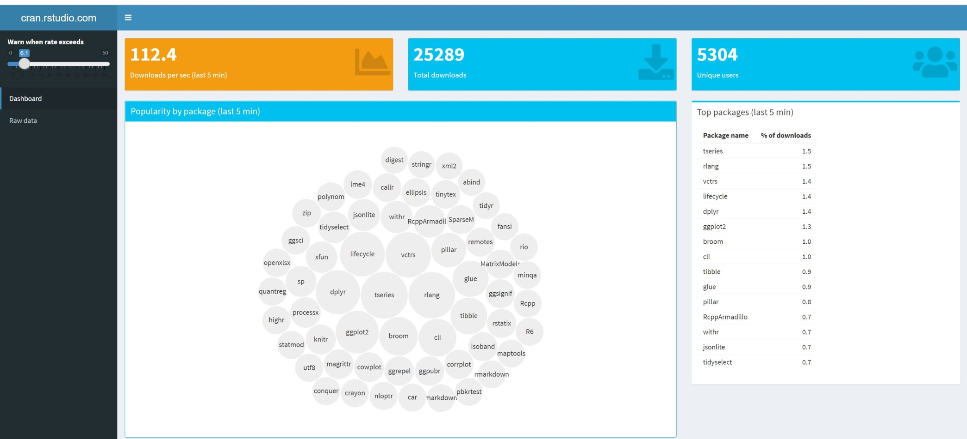
Streaming CRAN data shiny app

Slide 5
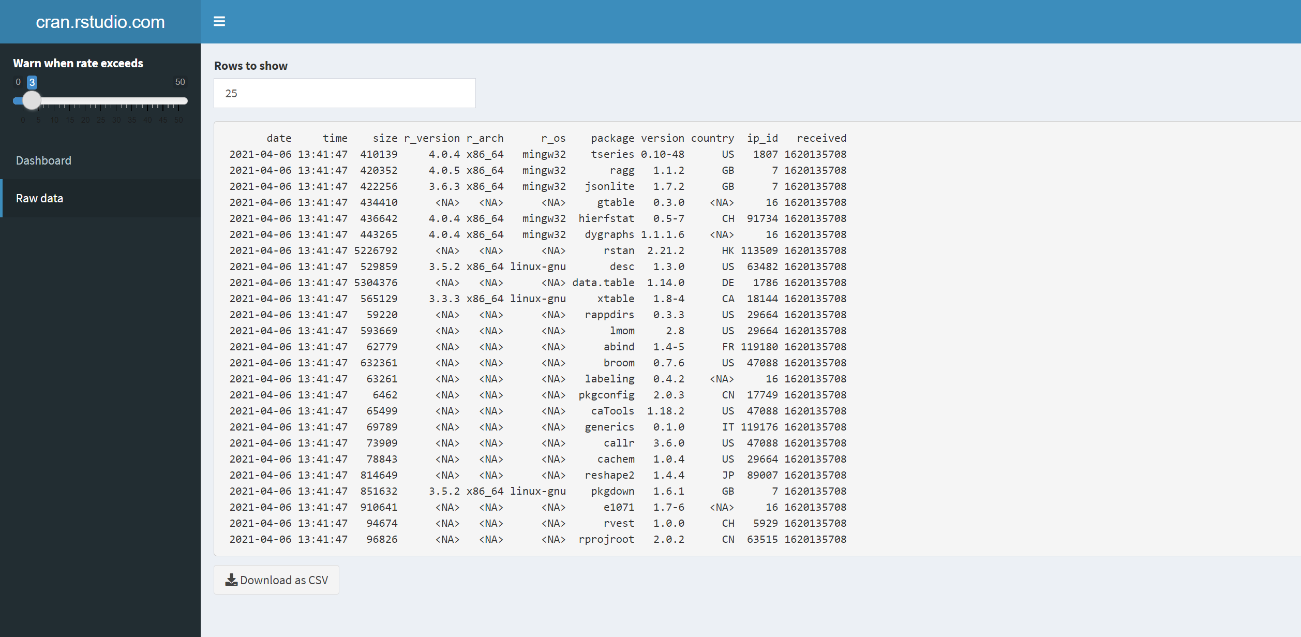
Access the app from: https://gallery.shinyapps.io/087-crandash/

Slide 6
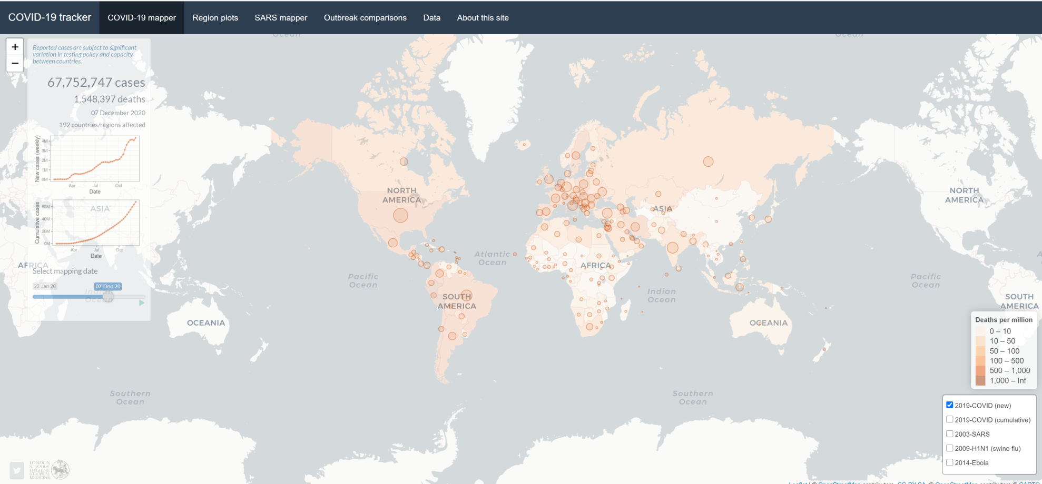
Covid-19 Tracker

Slide 7
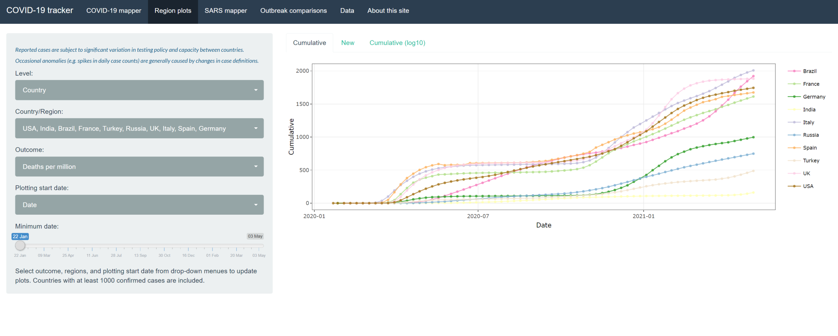
Access the app from: https://vac-lshtm.shinyapps.io/ncov_tracker/?_ga=2.94987164.1289489377.1620129325-21034900.1616759223

Slide 8
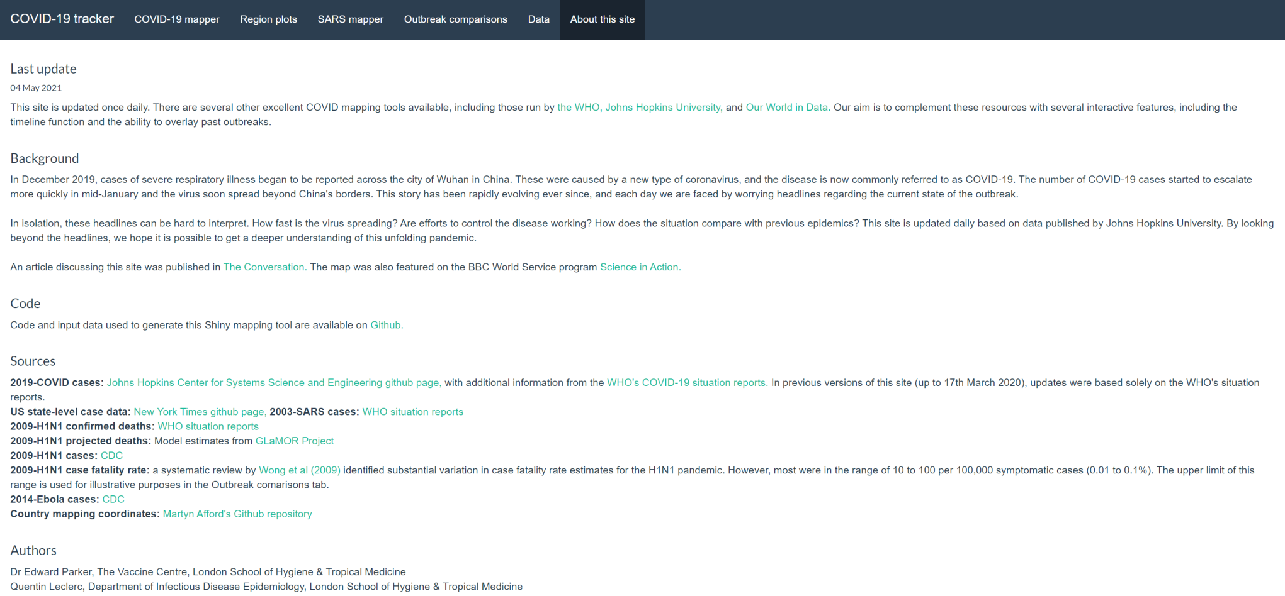

Slide 9
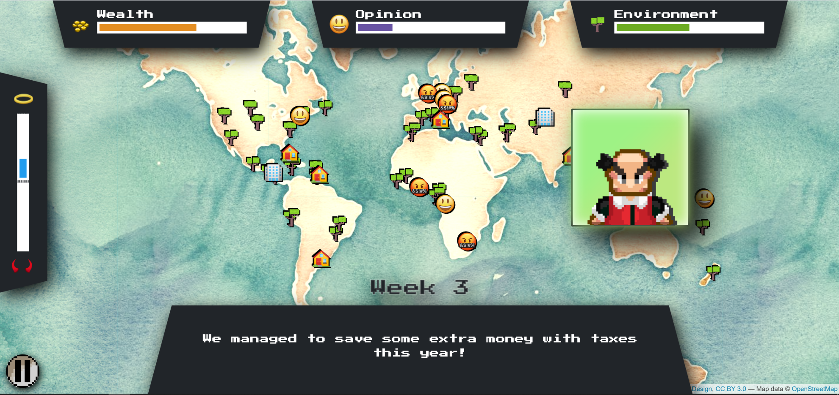
Shiny Decisions https://sparktuga.shinyapps.io/ShinyDecisions/?_ga=2.2819120.1289489377.1620129325-21034900.1616759223

Slide 10
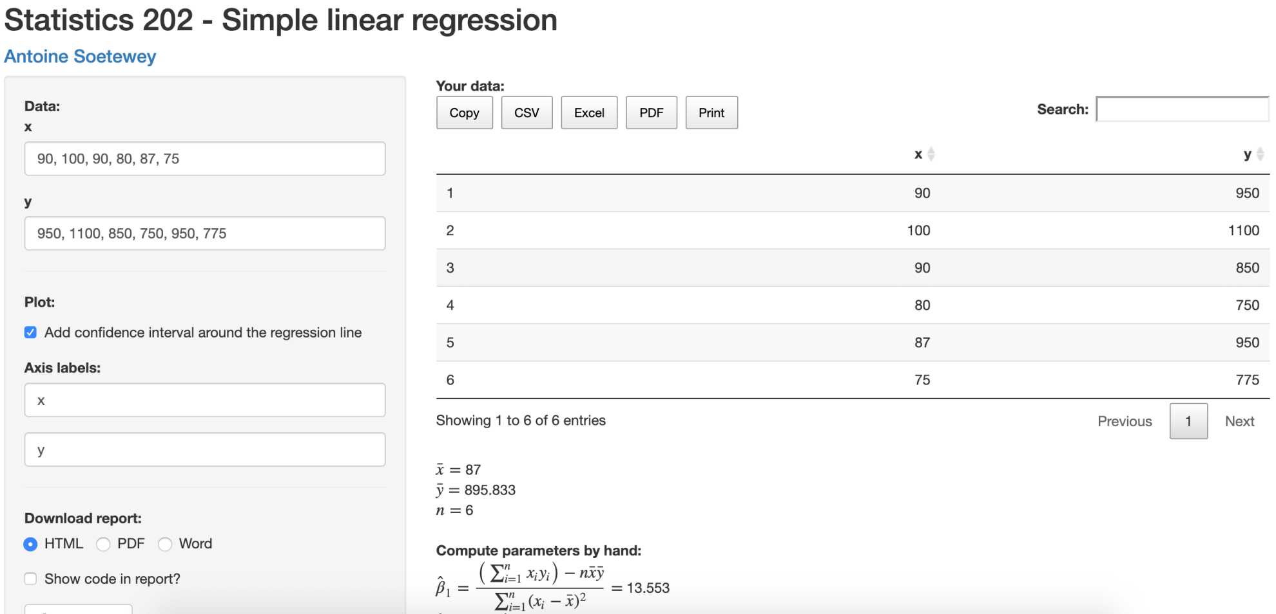
Calculator interface: https://antoinesoetewey.shinyapps.io/statistics-202

Slide 11
Interactivity – transform the analysis results into interactive web pages.
Flexibility – R shiny have multiple functions.
Creativity – You can always built your own “shiny” with your own design. Fully customizable and extensible.
Difference from BI tools(Tableau): Cheap(No cost needed), and basic R knowledge is needed.

Slide 12
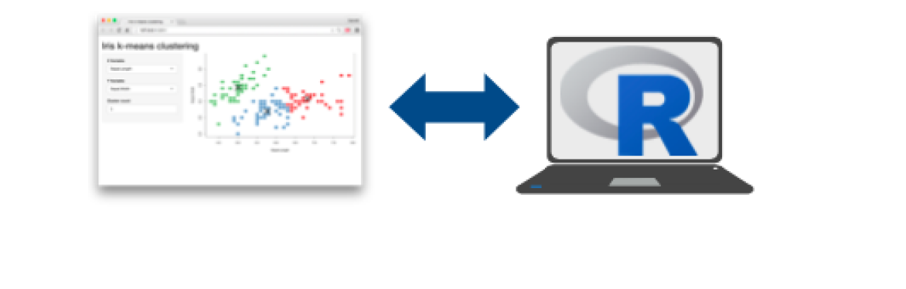
What is a Shiny App?
A Shiny app is a web page (UI) connected to a computer/server running a live R session (Shiny Server).
Users can manipulate the UI, the shiny server will run the R script to update the UI displays at the same time.

Slide 13
Shiny Structure
Shiny Apps can be developed with the following template in R:
app.R:
> library(shiny)
> ui <- fluidPage()
> server <- function(input,output)
> shinyApp(ui,server)
ui: Nested R functions that assemble an HTML user interface for the app.
server: A function with instructions on how to build and rebuild the R objects
displayed in the UI.
shinyApp: Combines ui and server into a functioning app.

Slide 14
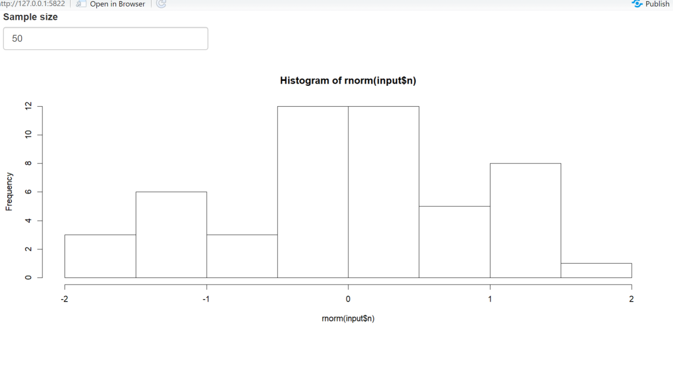
Example
> library(shiny)
> ui <- fluidPage(
+ numericInput(inputId="n","Sample size",value=50),
+ plotOutput(outputId= "hist1"))
> server <- function(input, output) {
+ output$hist1 <- renderPlot({hist(rnorm(input$n))})
+ }
> shinyApp(ui,server)
Access the current value of an input object with input$ < inputId >
Access the developed output of an output object with output$ < outputId>

Slide 15
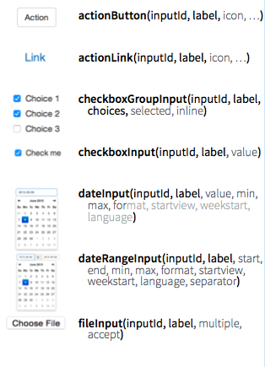
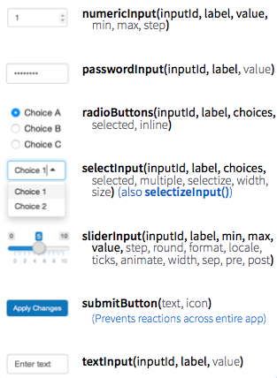
Different input functions are available:

Slide 16
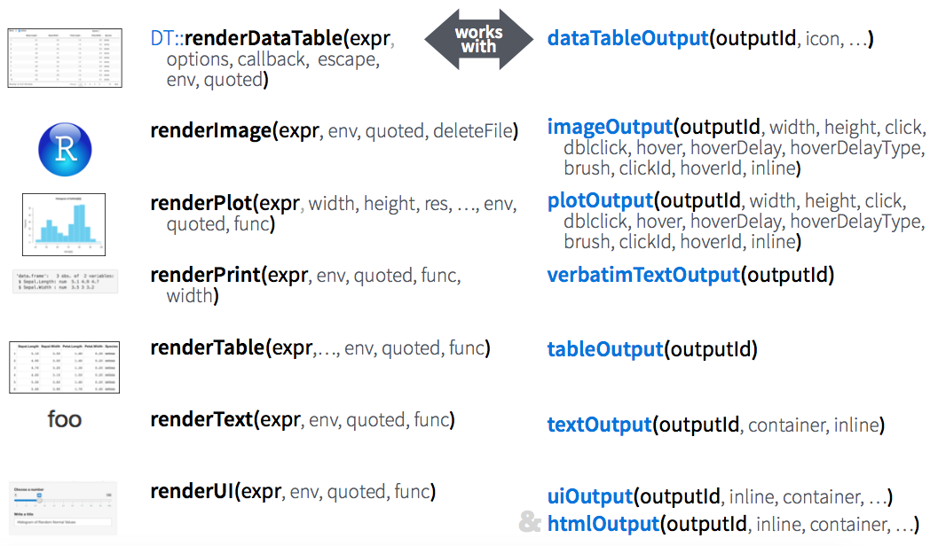
Different output functions are available:

Slide 17
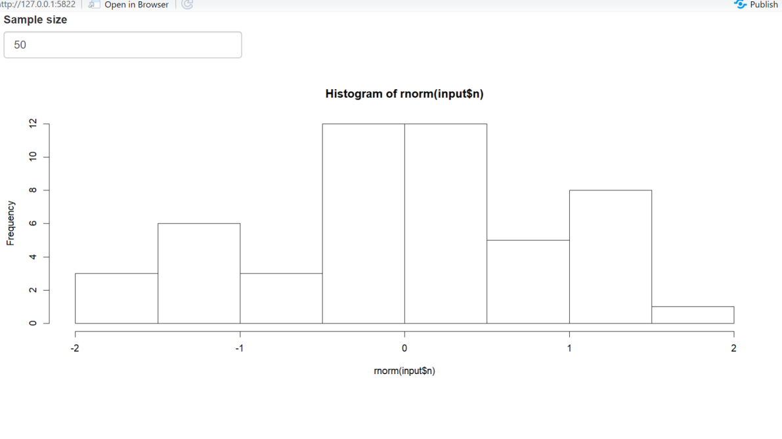
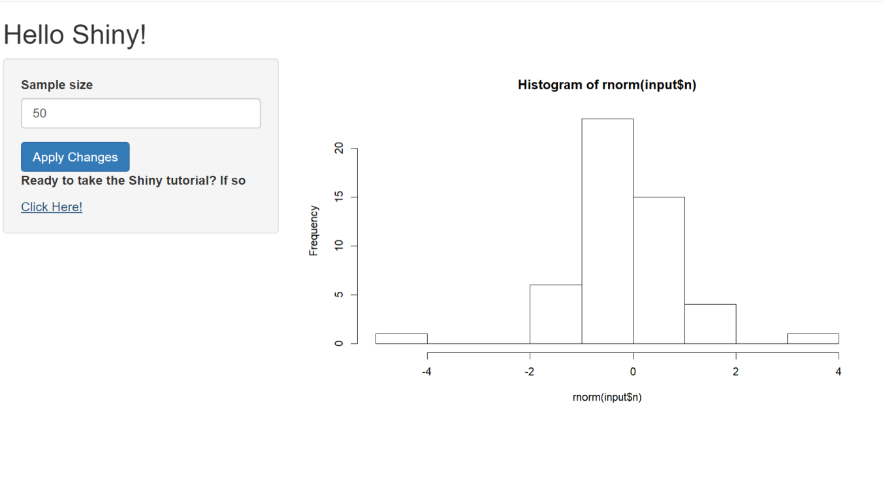
Before:
After:

Slide 18
New code:
ui <- fluidPage(
titlePanel("Hello Shiny!"),
# Sidebar layout with input and output definitions ----
sidebarLayout(
# Sidebar panel for inputs ----
sidebarPanel(
numericInput(inputId="n","Sample size",value=50),submitButton(),
# adding the new div tag to the sidebar
tags$div(class="header", checked=NA,
tags$p(strong("Ready to take the Shiny tutorial? If so")),
tags$a(href="https://shiny.rstudio.com/tutorial/", "Click Here!")
)),
# Main panel for displaying outputs ----
mainPanel(
plotOutput(outputId= "hist1"))))
server <- function(input, output) {
output$hist1 <- renderPlot({hist(rnorm(input$n))})
}
shinyApp(ui,server)

Slide 19
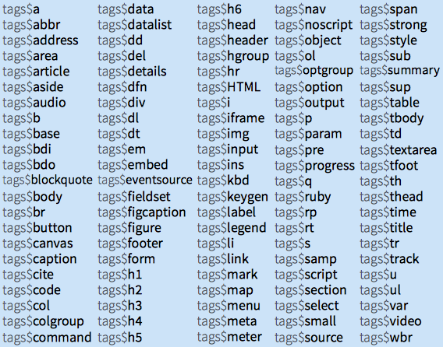
Static HTML elements can be added with tags, a list of functions that parallel common HTML tags, e.g. tags$a()
More details can be found : https://shiny.rstudio.com/articles/tag-glossary.html

Slide 20
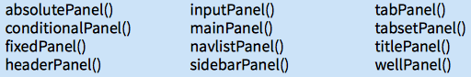
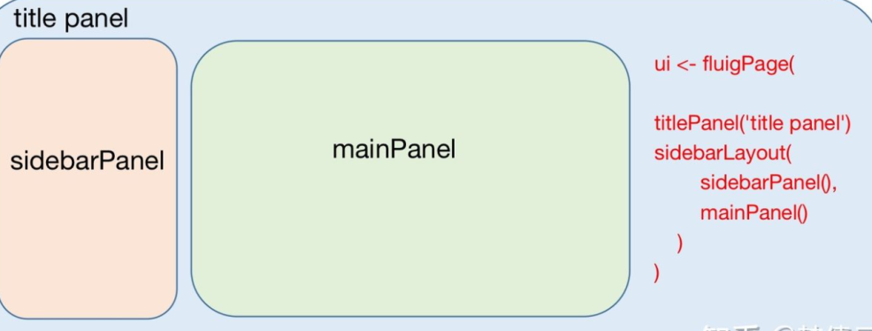
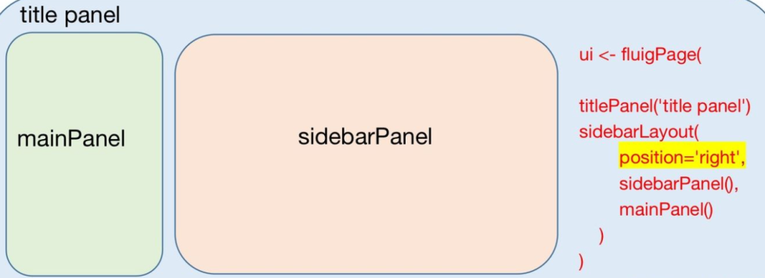
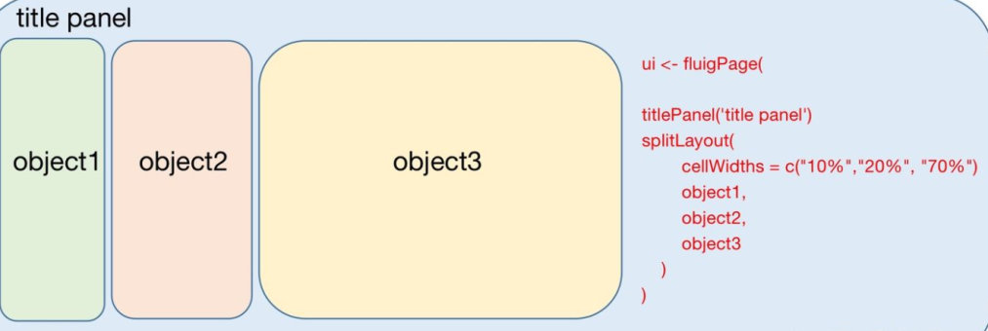
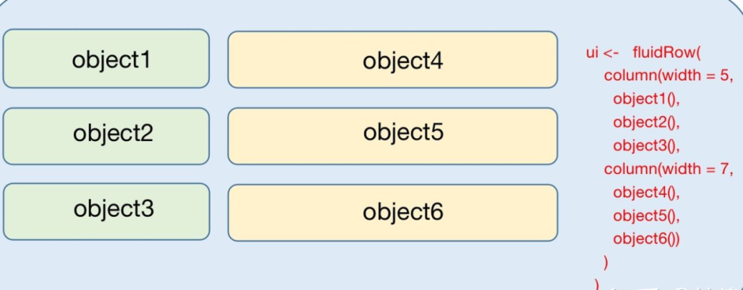
Layout of UI
Different panels are available:
Common layouts

Slide 21
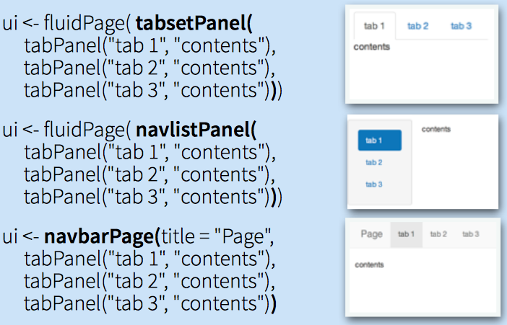
Layer tabPanels on top of each other, and navigate between them
R shiny:
Web interface for R
Designed to deliver small apps
Simple rules based layout structures

Slide 22
Step by step to build a shiny app
Analyse the irish dataset by creating three tabsets in the main panel. The first one contains a histogram per chosen variable (variable name/bin size/color), while the second one displays a summary output of all variables and the third one displays the data table. Variable selection is obtained by a select input.
Interface Design:
Sidebar
Panel (select input for different variables)
Histogram
Summary
Data

Slide 23
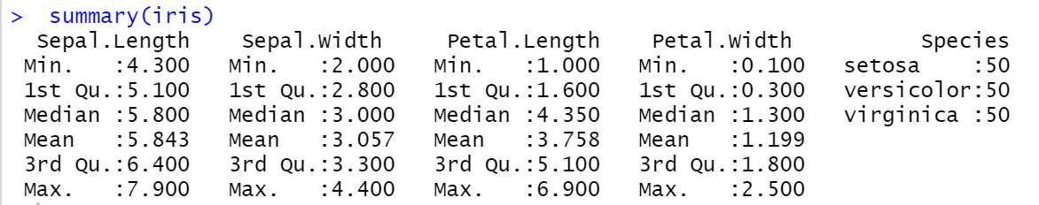
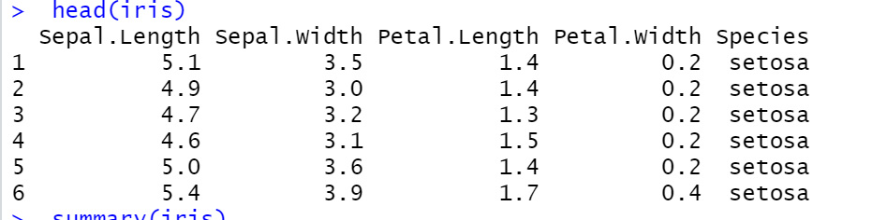
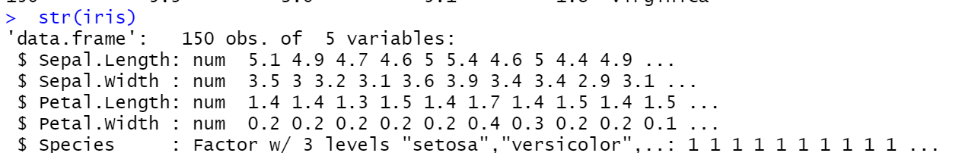
Step 1: Load the package and iris data
install.packages("shiny")
library(shiny)
iris
str(iris)
head(iris)
summary(iris)

Slide 24
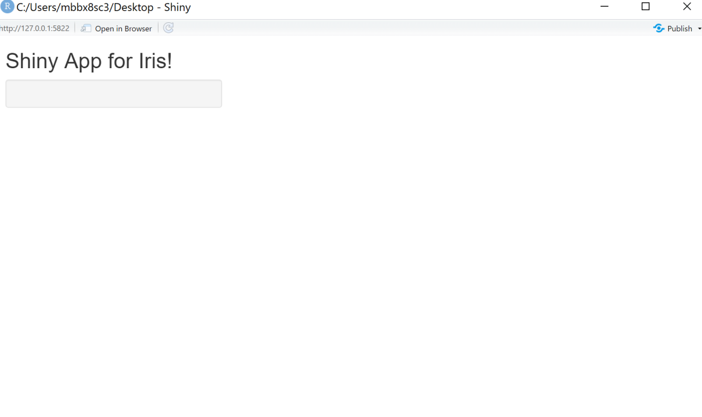
Step 2: Build the basic framework for R shiny
ui <- fluidPage(
titlePanel(title = "Shiny App for Iris!"),
# Sidebar layout with input and output definitions ----
sidebarLayout(
# Sidebar panel for inputs
sidebarPanel(
),
# Main panel for displaying outputs
mainPanel(
)
)
)
server <- function(input,output){}
shinyApp(ui,server)

Slide 25
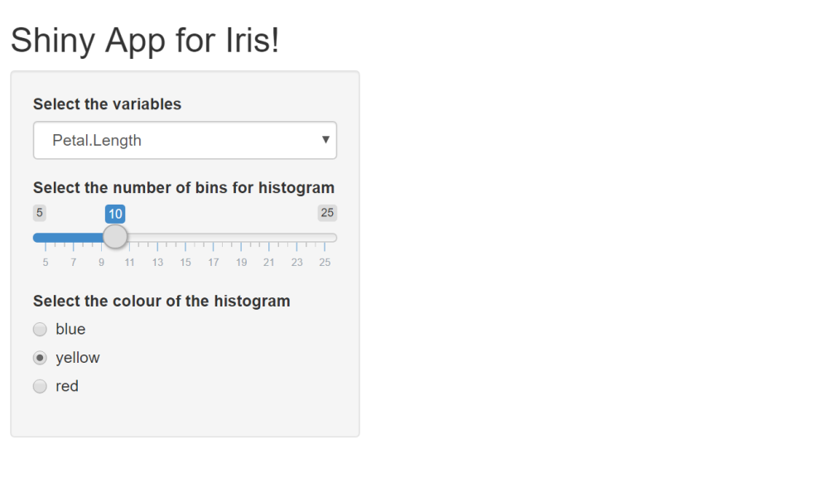
Step 3: Create the input structure in the sidebar panel
ui <- fluidPage(
titlePanel(title = "Shiny App for Iris!"),
# Sidebar layout with input and output definitions ----
sidebarLayout(
# Sidebar panel for inputs ----
sidebarPanel(
selectInput(inputId="var","Select the variables",choices = c("Sepal.Length"=1,"Sepal.Width"=2,"Petal.Length"=3,"Petal.Width"=4),selected=3,selectize = FALSE),
sliderInput(inputId="bin","Select the number of bins for histogram",min=5, max=25,value=10),
radioButtons(inputId="colour",label="Select the colour of the histogram",choices = c("blue","yellow","red"),selected="yellow")
),
# Main panel for displaying outputs ----
mainPanel(
)
)
)
server <- function(input,output){}
shinyApp(ui,server)

Slide 26
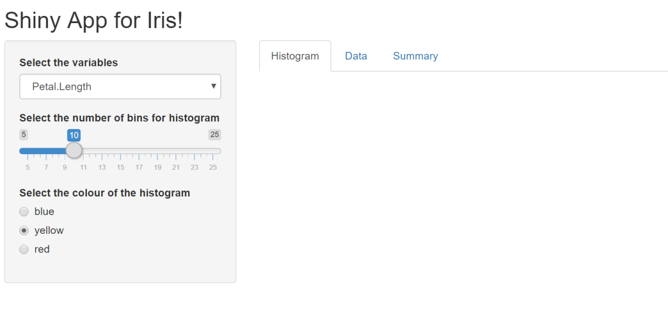
Step 4: Create tabsets with outputs in the UI main panel
ui <- fluidPage(
titlePanel(title = "Shiny App for Iris!"),
# Sidebar layout with input and output definitions ----
sidebarLayout(
# Sidebar panel for inputs ----
sidebarPanel(
selectInput(inputId="var","Select the variables",choices = c("Sepal.Length"=1,"Sepal.Width"=2,"Petal.Length"=3,"Petal.Width"=4),selected=3,selectize = FALSE),
sliderInput(inputId="bin","Select the number of bins for histogram",min=5, max=25,value=10),
radioButtons(inputId="colour",label="Select the colour of the histogram",choices = c("blue","yellow","red"),selected="yellow")
),
# Main panel for displaying outputs ----
mainPanel(
tabsetPanel(type="tab",
tabPanel("Histogram",textOutput(outputId="text"),plotOutput(outputId="hist")),
tabPanel("Data",DTOutput(outputId ="Data_Iris")),
tabPanel("Summary",tableOutput(outputId="summary"))
)
)
)
)
server <- function(input,output){}
shinyApp(ui,server)

Slide 27
Step 5: Write up the server part
ui <- fluidPage(
titlePanel(title = "Shiny App for Iris!"),
# Sidebar layout with input and output definitions ----
sidebarLayout(
# Sidebar panel for inputs ----
sidebarPanel(
selectInput(inputId="var","Select the variables",choices = c("Sepal.Length"=1,"Sepal.Width"=2,"Petal.Length"=3,"Petal.Width"=4),selected=3,selectize = FALSE),
sliderInput(inputId="bin","Select the number of bins for histogram",min=5, max=25,value=10),
radioButtons(inputId="colour",label="Select the colour of the histogram",choices = c("blue","yellow","red"),selected="yellow")
),
# Main panel for displaying outputs ----
mainPanel(
tabsetPanel(type="tab",
tabPanel("Histogram",textOutput(outputId="text"),plotOutput(outputId="hist")),
tabPanel("Data",DTOutput(outputId ="Data_Iris")),
tabPanel("Summary", verbatimTextOutput(outputId="summary"))
))))
server <- function(input,output){
output$Data_Iris <- renderDT({
datatable(iris)
})
output$text <- renderText({
col=as.numeric(input$var)
paste("The variable names you choose here is ", names(iris[col]))
})
output$hist <- renderPlot({
col=as.numeric(input$var)
hist(iris[,col],col=input$colour,xlim=c(0,max(iris[,col])),breaks=seq(0,max(iris[,col]),l=input$bin+1),xlab=names(iris[col]),main="Histogram of Iris dataset")
})
output$summary <-renderPrint({
summary(iris)
}) }
shinyApp(ui,server)

Slide 28
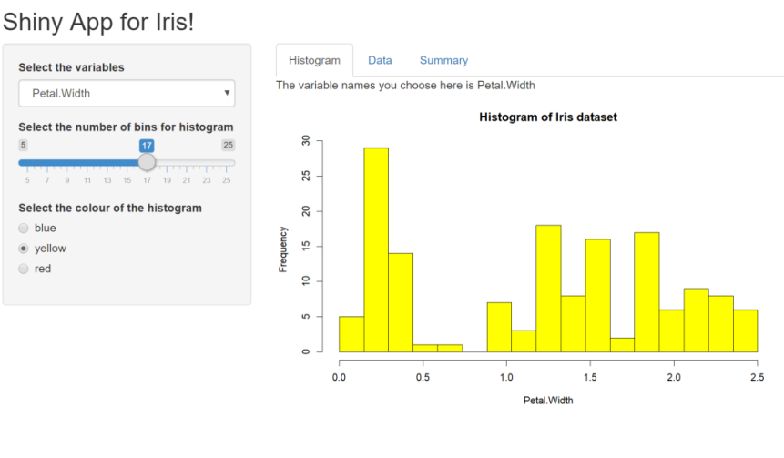
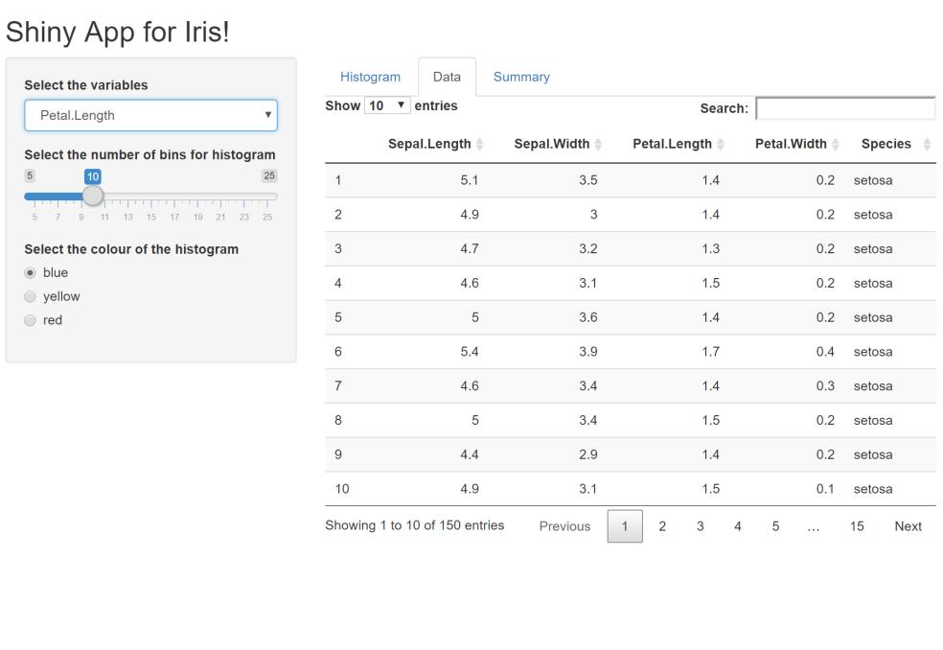
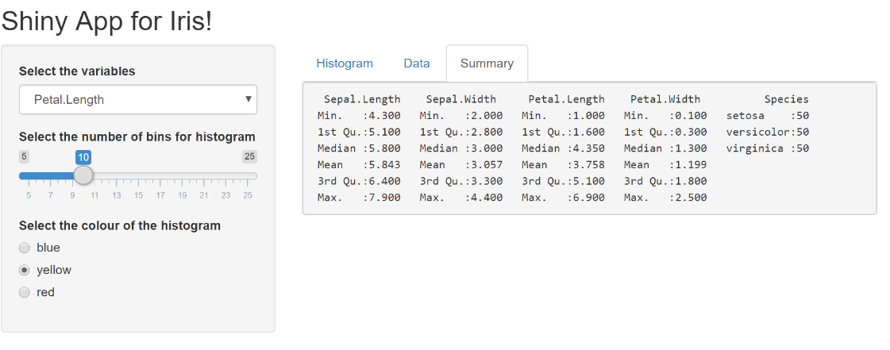

Slide 29
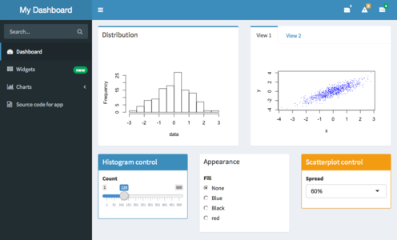
Extension to dashboard shells
Build-in UI framework of Shiny is rather simple .
The layout of interface is neat but plain.
Customize your UI with HTML, CSS and Javascript widgets (Time consuming).
shinydashboard package

Slide 30
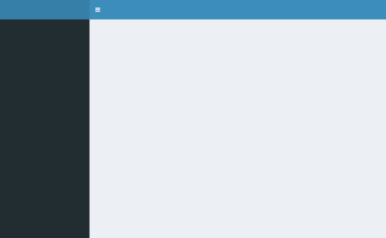
Basics of shinydashboard
install.packages("shinydashboard")
library(shiny)
library(shinydashboard)
ui <- dashboardPage(
dashboardHeader(),
dashboardSidebar(),
dashboardBody() )
server <- function(input, output) { }
shinyApp(ui, server)

Slide 31
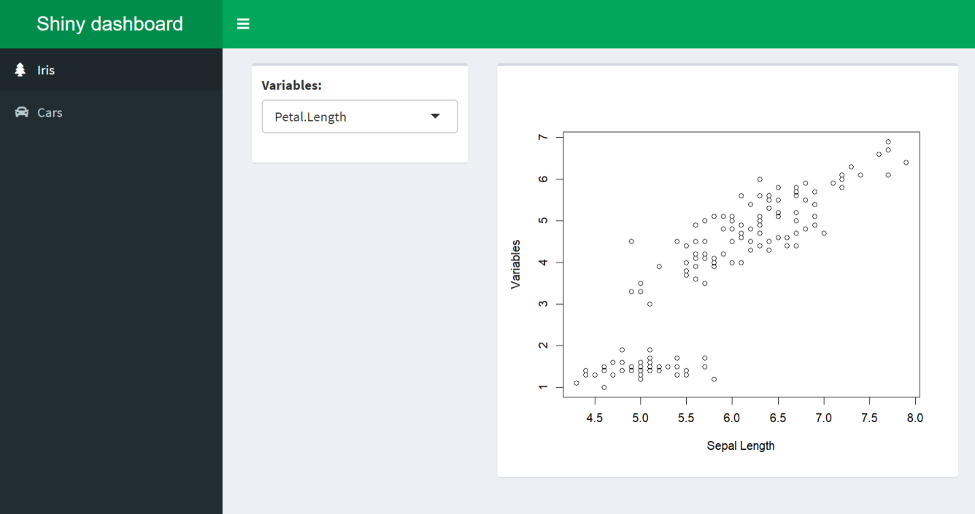
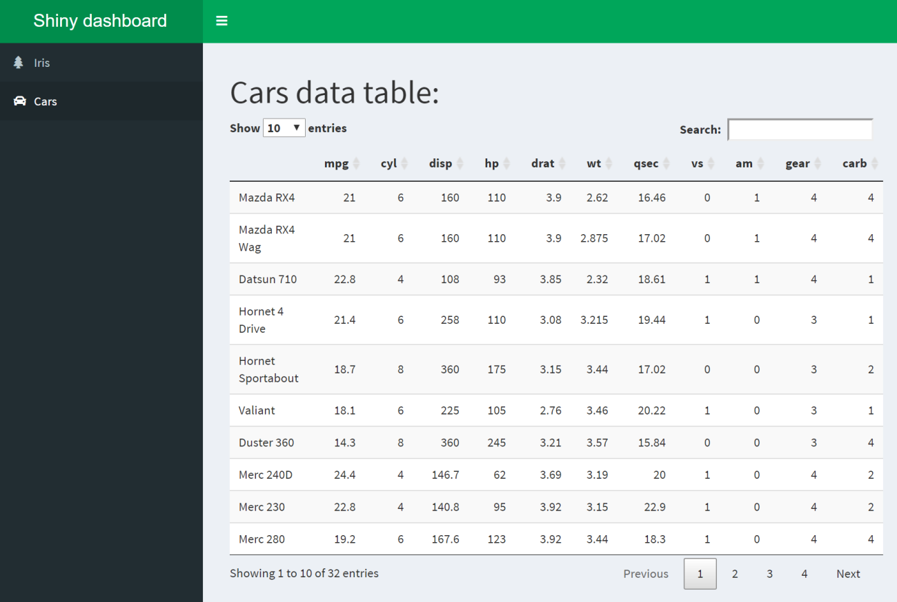

Slide 32
Load the packages and data
install.packages("shinydashboard")
install.packages("Dt")
library(shiny)
library(shinydashboard)
head(iris)
head(mtcars)

Slide 33
ui = dashboardPage(skin="green",
dashboardHeader(title="Shiny dashboard"),
dashboardSidebar(
sidebarMenu(
menuItem("Iris", tabName = "iris", icon = icon("tree")),
menuItem("Cars", tabName = "cars", icon = icon("car"))
)
),
dashboardBody(
tabItems(
tabItem("iris",
box(selectInput("variables","Variables:",choices=c("Sepal.Width","Petal.Length","Petal.Width")),width=4),
box(plotOutput("Correlation_iris"),width=8)
)
,
tabItem("cars",
fluidPage(
h1("Cars data table:"),
DTOutput(outputId ="Data_car")
)
)
)
)
)

Slide 34
server = function(input, output) {
output$Correlation_iris <- renderPlot({
plot(iris$Sepal.Length,iris[[input$variables]],xlab="Sepal Length",ylab="Variables")
})
output$Data_car <- renderDT({ mtcars
})
}
shinyApp(ui,server )

Slide 35
Learn more here:
R shiny tutorial: https://shiny.rstudio.com/tutorial/
https://shiny.rstudio.com/tutorial/written-tutorial/
https://shiny.rstudio.com/gallery/
R shiny dashboard ：https://rstudio.github.io/shinydashboard/get_started.html
https://rstudio.github.io/shinydashboard/structure.html
Popular shiny app examples: https://blog.rstudio.com/2020/07/13/winners-of-the-2nd-shiny-contest/

Slide 36
Thank you!

